Slide 1
Based on : On Pairing of Bipolar RRAM Memory With NPN Selector Based on Set/Reset Array Power Considerations
EE658 : Memory Device Technologies and Applications
Course Instructor : Prof. Sandip Lashkare
Power Analysis of RRAM Crossbar with and without Selector
Kalaparthi Vikas (25210064)
Prem Singh (25210098)
Dheekshitha (22110176)

Slide 2
Table of contents
01
02
03
04
05
06
07
Problem Statement
Device Structure
Single Cell Analysis (1M)
Selector-Based Cell (1S1M)
3×3 Array Analysis
Results & Power Comparison
RRAM Results

Slide 3
Problem Statement
Need for the proposed design

Slide 4
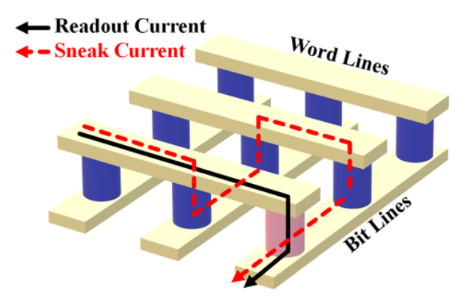
The Need: Overcoming the "Sneak Path"
Sneak Path Leakage: Unintended current flow through neighboring unselected cells.
High Power Consumption: Parasitic paths cause massive energy waste in large arrays.
Reduced Read Margin: Leakage makes it difficult to distinguish between logic '0' and '1'.
Requirement: A Selector (1S1R) is essential to block leakage and enable reliable scaling

Slide 5


Device Structure
RRAM uses 1S1M architecture

Slide 6
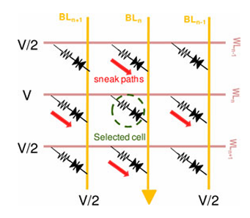
Architecture: Why 1S1M?
Non-Linear Switch: The Selector (1S) acts as a high-resistance "open circuit" for any voltage below the threshold (V < V_th).
Threshold Triggering: Only the full-bias (V_app) at the selected intersection triggers conduction; half-bias (V_app/2) nodes remain non-conductive.
Cell Isolation: Decouples the memory element (1M) from the rest of the array, ensuring the Bit Line only "sees" the target cell.
Energy Efficiency: Drastically lowers static power by keeping unselected cells in a near-zero current state.

Slide 7
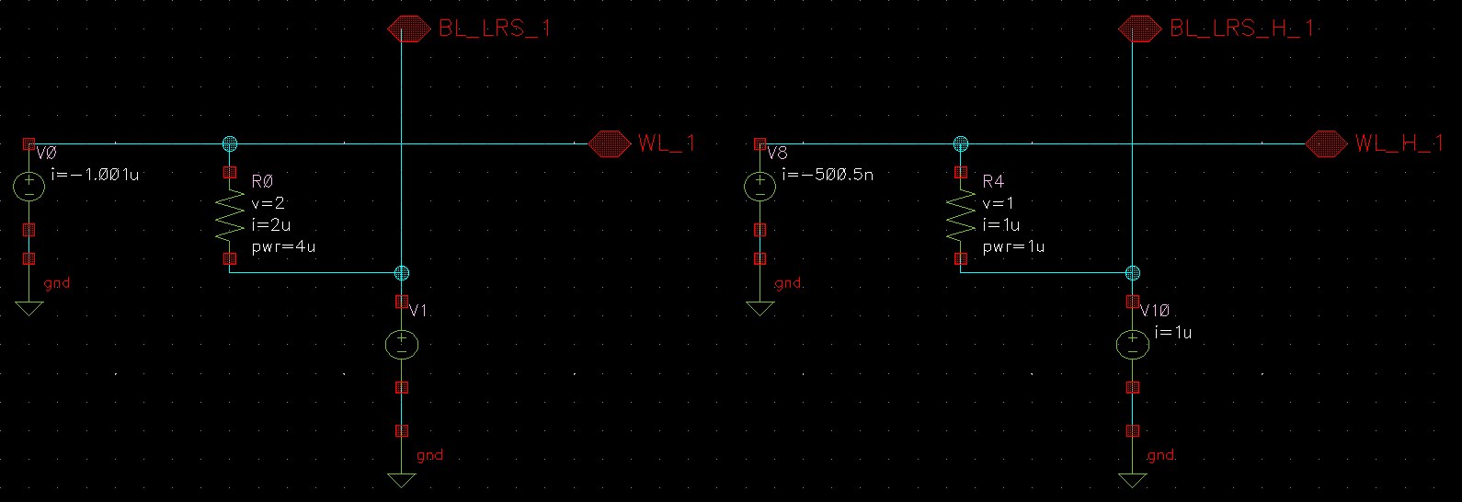
Single Cell Analysis (1M)
LRS - 1M ohm

Slide 8
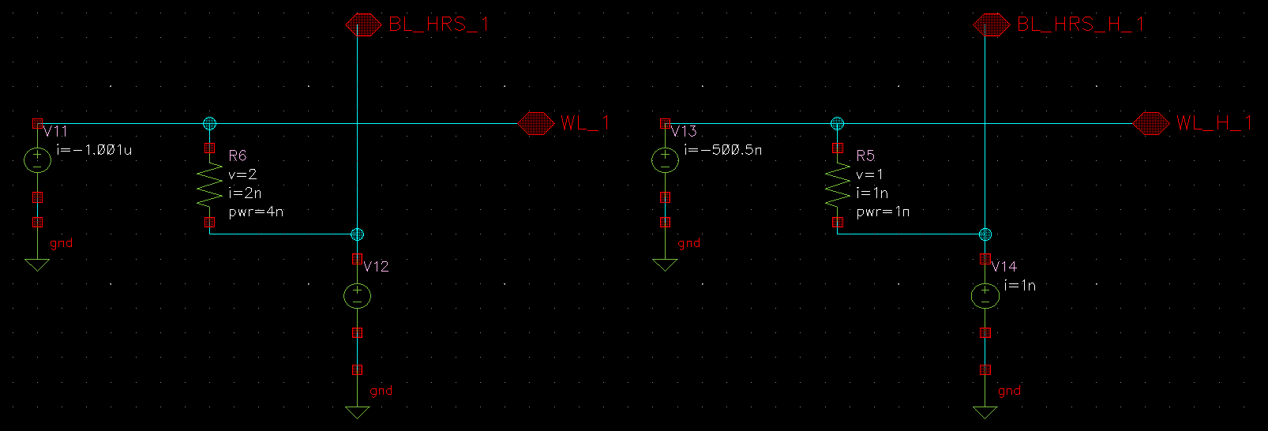
Single Cell Analysis (1M)
HRS - 1G ohm

Slide 9
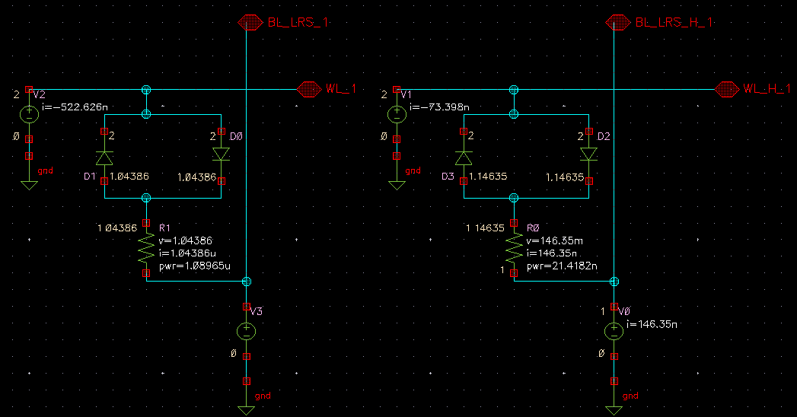
Selector-Based Cell (1S1M)
LRS

Slide 10
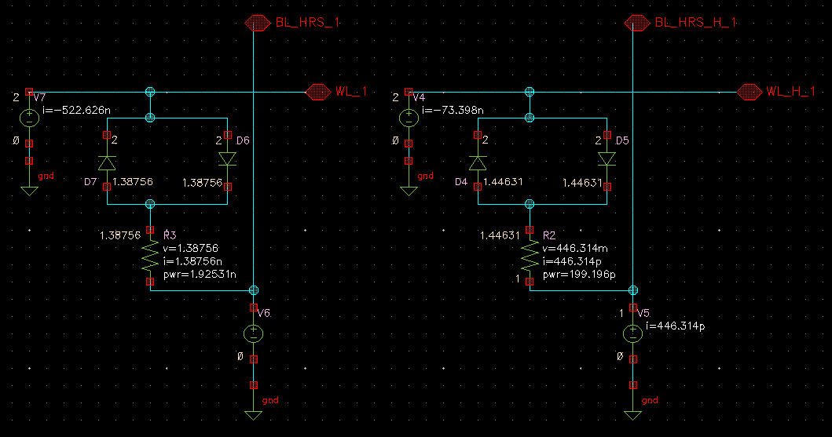
Selector-Based Cell (1S1M)
HRS

Slide 11
Power Comparison (1M vs 1S1M)
CASE | STATE | SELECTED CELL POWER (W) | HALF SELECTED CELL POWER (W)
1M | LRS | 4u | 1u
 | HRS | 4n | 1n
1S1M | LRS | 1.089u | 21.418n
 | HRS | 1.925n | 199.196p

Slide 12
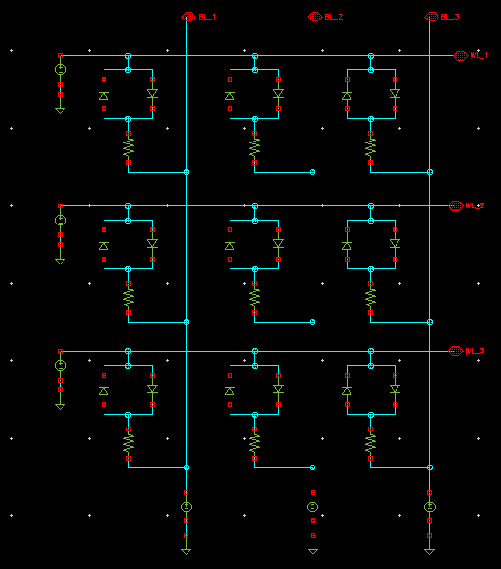
3×3 Array Analysis

Slide 13
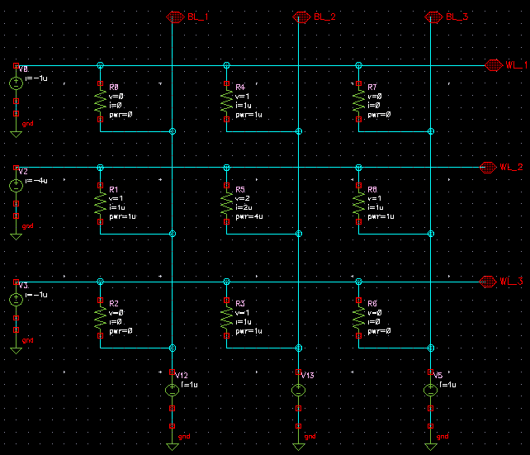
3×3 Array Analysis
Without
Selector
(LRS)
TOTAL POWER = 8uW

Slide 14
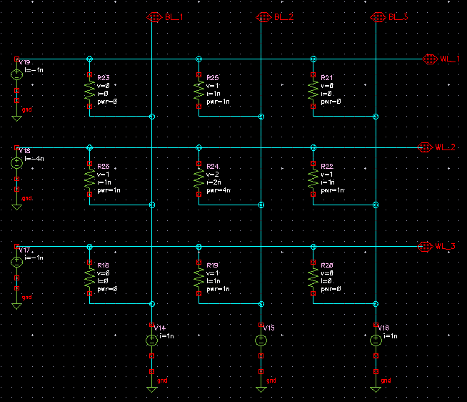
3×3 Array Analysis
Without
Selector
(HRS)
TOTAL POWER = 8nW

Slide 15
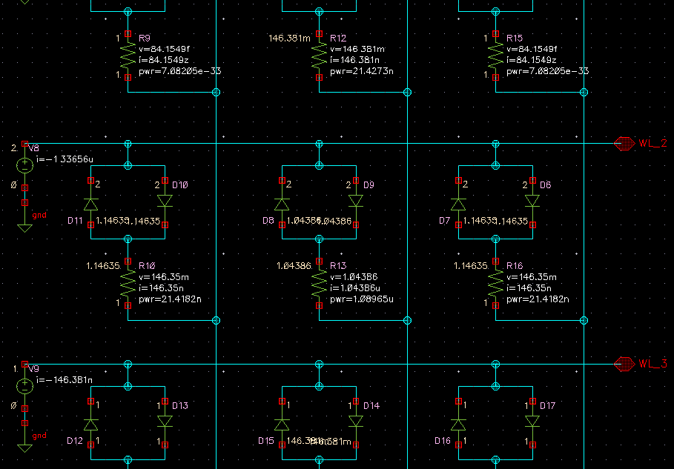
3×3 Array Analysis
With
Selector
(LRS)
TOTAL POWER = 1.174uW

Slide 16
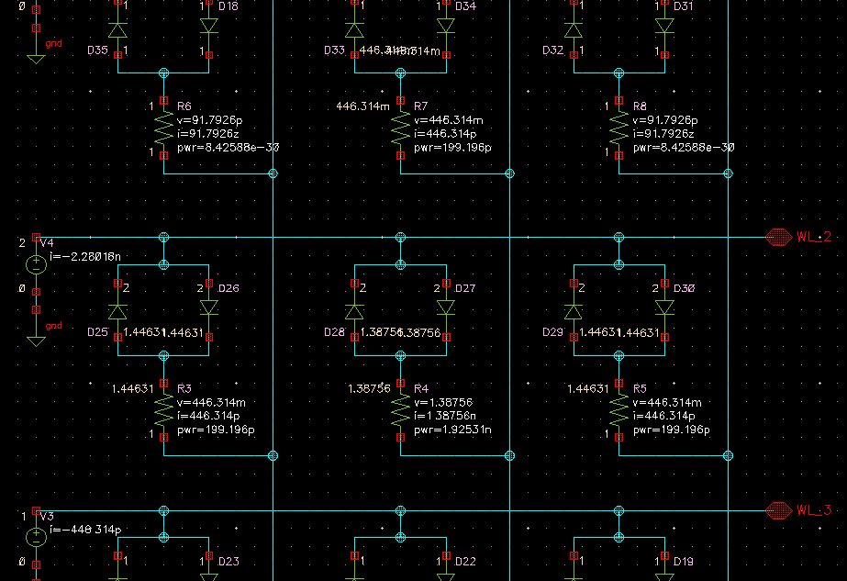
3×3 Array Analysis
With
Selector
(HRS)
TOTAL POWER = 2.721nW

Slide 17
Power Comparison (3x3 array)
CASE | STATE | SELECTED CELL POWER (W) | HALF SELECTED CELL POWER (W) | TOTAL POWER (W)
3×3 Array Without Selector | LRS | 4u | 1u | 8u
 | HRS | 4n | 1n | 8n
3×3 Array With Selector | LRS | 1.089u | 21.418n | 1.174u
 | HRS | 1.925n | 199.196p | 2.721n

Slide 18
Results
So in 3x3 array the power reduction after introducing selector device is:
LRS power reduced by ≈ 6.8 times.
HRS power reduced by≈ 3 times.

Slide 19
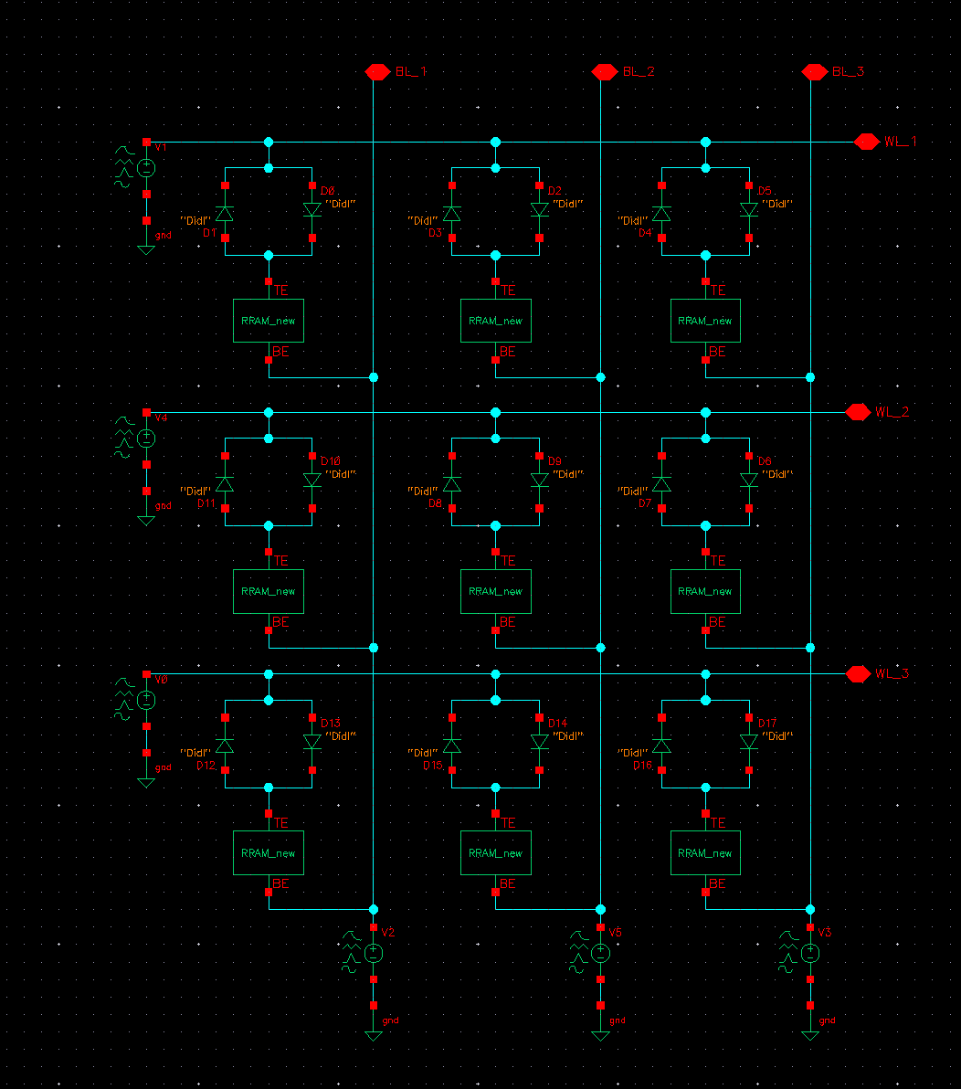
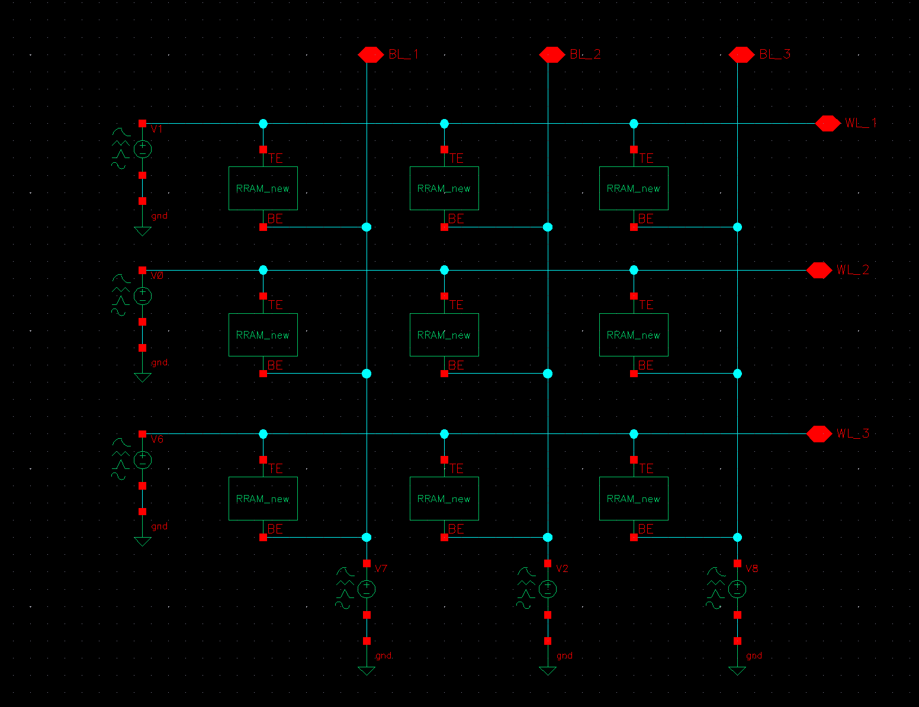
RRAM 3x3 array
Without selector device
With selector device

Slide 20
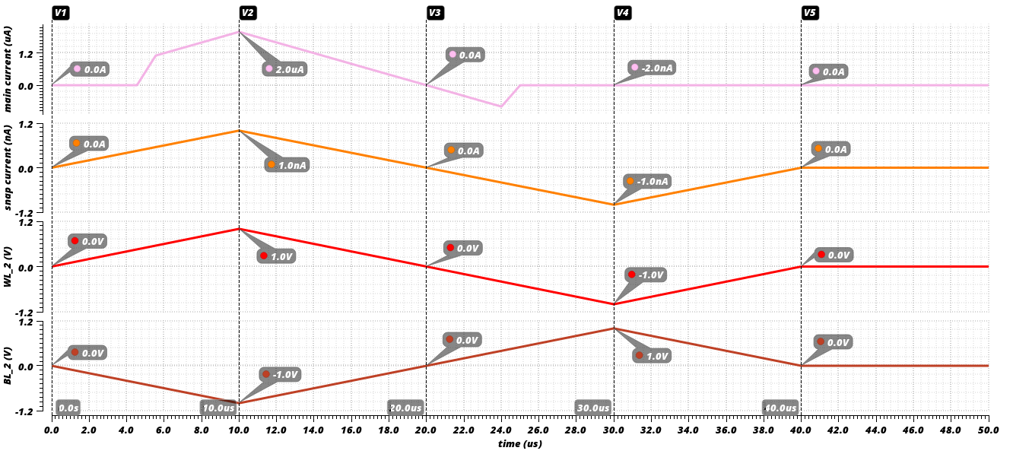
Transient Analysis of RRAM without selector

Slide 21
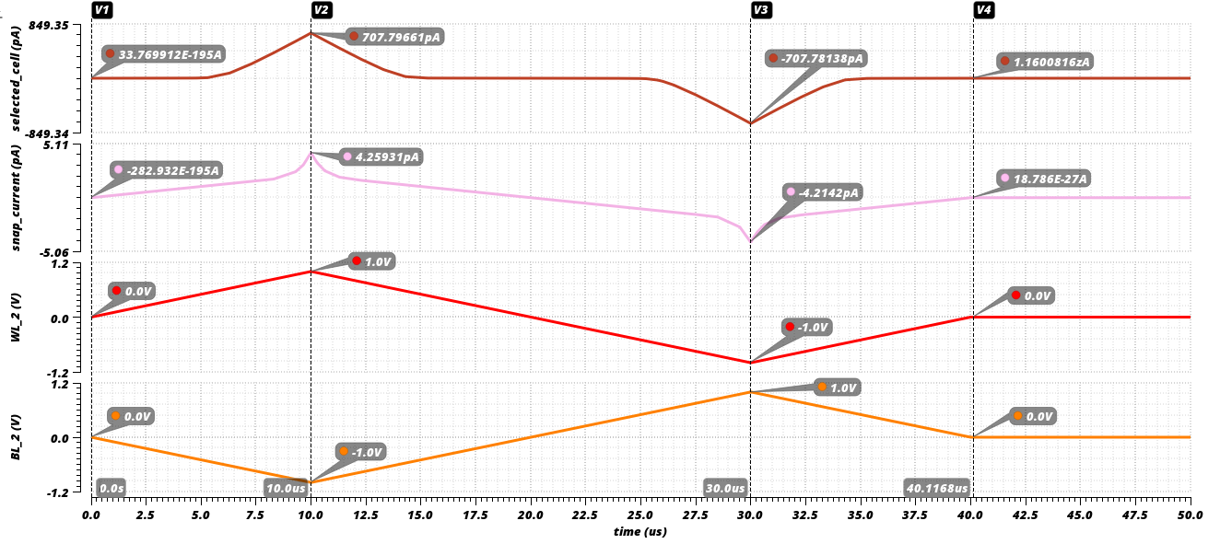
Transient Analysis of RRAM with selector

Slide 22
THANK YOU

